Slide 1
Mission Xero
Lennard John

Slide 2
Agenda
Mission brief
Non-technical
Technical
Desktop
Mobile
Brain-Storm
Colour
Challenges
Framework
Components
Challenges
Live Tour

Slide 3
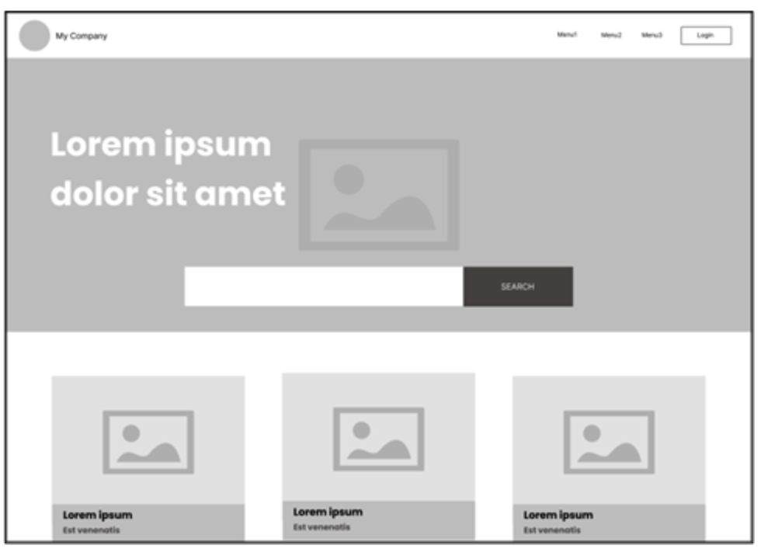
Brief
Desktop view

Slide 4
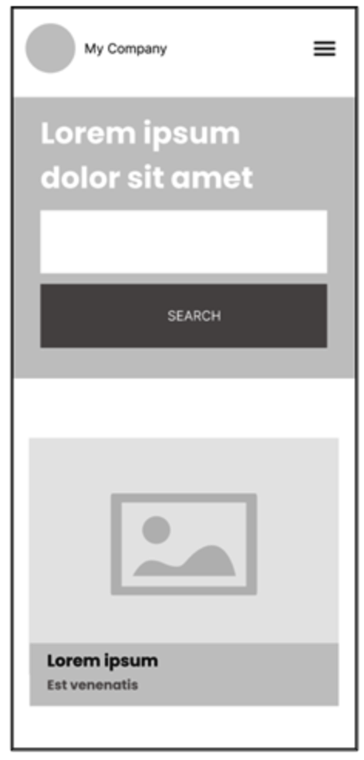
Brief
Mobile View

Slide 5

Non-Technical
Topic

Slide 6
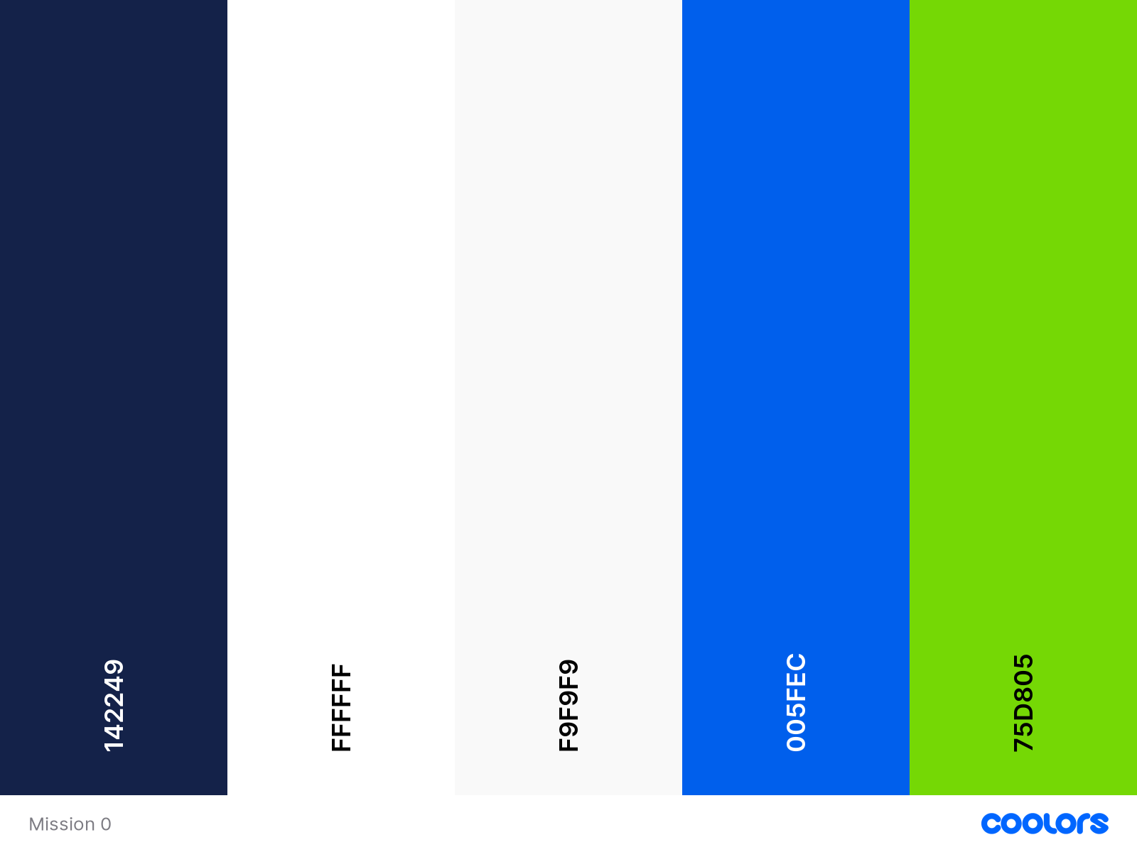
Non-Technical
Color

Slide 7

Challenges
What should I choose?
This is why we need UX designers.

Slide 8
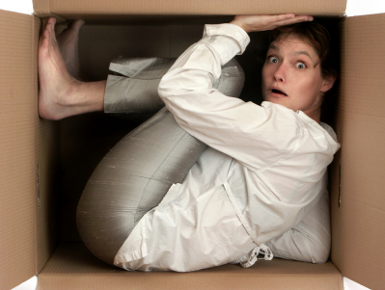
Challenges
Oh, I can do add this and that.

Slide 9

Technical
Framework

Slide 10
Feedback
Font needed to be consistent.
Navigation
Shadows around image and cards
Search Bar
Framework

